Slide 1
System Programming
Chapter Three :Loader and linker
Haymanot F.(M.Sc.)
Debre markos university
School of computing
Department of Software Engineering
2013 E.C.

Slide 2
contents
Basic Loader Functions
Machine-Dependent Loader Features
Machine-Independent Loader Features
Loader Design Options

Slide 3
Introduction
The Source Program written in assembly language or high level language will be converted to object program
This conversion either using assembler or compiler, contains translated instructions and data values from the source program,
Or specifies addresses in primary memory where these items are to be loaded for execution.
It has 3 processes
Linking: combines two or more separate object programs and supplies the information needed to allow references between them.
  Generates the executable files of program ,takes input of object code generated by assembler/compiler
Loading: loads the executable files obtained from linker in to main memory for execution.
  Also allocates space to executable files in main memory
Relocation: modify the object program so that it can be loaded at an address from the location originally specified.

Slide 4
Basic loader functions
A loader is a system program that performs the loading function.
It brings object program into memory and starts its execution.
Many loaders also support relocation and linking.
Some systems have a linker to perform the linking and a separate loader to handle relocation and loading.
Source Program →Translator -> Object program -> Loader -> Object program ready for execution
Different types of loaders are, absolute loader, bootstrap loader, relocating loader (relative loader), and, direct linking loader.
Notes:
Types Of Loader
Absolute loader
Bootstrap loader
Relocating loader/ relative loader /
Direct linking loader

Slide 5
Absolute Loader
An object program is loaded at the address specified on the START directive.
At the end the loader jumps to the specified address to begin execution of the loaded program.
Absolute loader only performs loading function
  Does not need to perform linking and program relocation.
  All functions are accomplished in a single pass
The advantage of absolute loader is simple and efficient.
The disadvantages are,
  The need for programmer to specify the actual address,
  Difficult to run several programs concurrently, sharing memory between them.
  and, difficult to use subroutine libraries efficiently.
Notes:
a subroutine: is a sequence of program instructions that performs a specific task
a library is a collection of non-volatile resources used by computer programs, often for software development. These may include configuration data, documentation, help data, message templates, pre-written code and subroutines, classes, values or type specifications.

Slide 6
Absolute Loader CON…
In a single pass :
Check the Header record for program name, starting address, and length
Bring the object program contained in the Text record to the indicated address
No need to perform program linking and relocation
Start the execution by jumping to the address specified in the End record

Slide 7
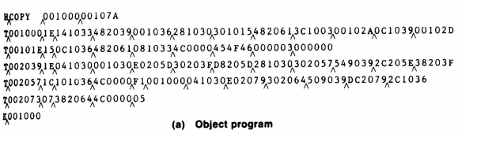
Absolute Loader example

Slide 8
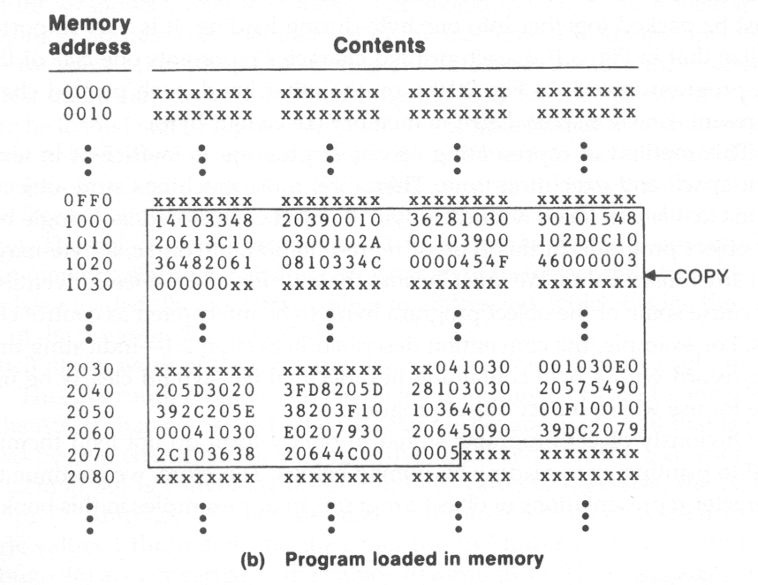
No text record corresponds here.
XXX indicates that the previous
contents of these locations remain
unchanged.

Slide 9
Bootstrap Loader
When a computer is first turned on or restarted, a special type of loader, called bootstrap loader is executed.
  In PC, BIOS acts as a bootstrap loader
The bootstrap loader loads the first program to be run by the computer – usually the operating system
No header record or control information, the object code is consecutive bytes of memory.
It then jumps to the loaded program to execute it.
Normally, the loaded program is very small (e.g., a disk sector’s size, 512 bytes) and is a loader itself.
The loaded loader will continue to load another larger loader and jump to it.
This process repeats another until the entire large operating system is loaded.
Notes:
BIOS (basic input/output system) is the program a computer's microprocessor uses to start the computer system after it is powered on. It also manages data flow between the computer's operating system (OS) and attached devices, such as the hard disk, video adapter, keyboard, mouse and printer.

Slide 10
Machine dependent loader features
Solution: for the drawback of absolute loader
  Program relocation
  Program linking
Relocating Loader: loading+relocation
Loaders that allow for program relocation are called relocating loaders or relative loaders
The concept of program relocation is, the execution of the object program using any part of the available and sufficient memory.
The object program is loaded into memory wherever there is room for it.
The actual starting address of the object program is not known until load time.

Slide 11
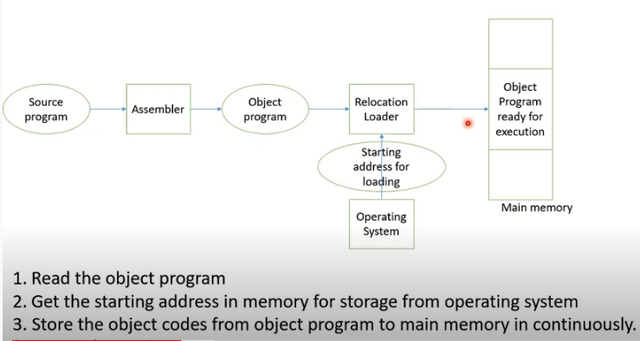
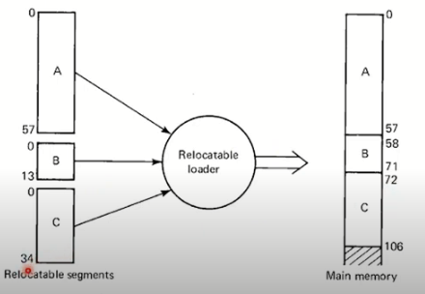
Relocation example

Slide 12
Relocating Loader….
Relocation provides the efficient sharing of the machine with larger memory and when several independent programs are to be run together.
It also supports the use of subroutine libraries efficiently.
Two methods to describe where in the object program to modify the address (add the program starting address)
  Use modification records
    Suitable for a small number of changes
  Use relocation bit mask
    Suitable for a large number of changes

Slide 13
Relocating Loader…
Modification records(M): is used to describe each part of the object code that must be changed when the program is relocated..
The format of the modification record (M) is as follows:
col 1: M
col 2-7:starting location address filed to be modified
col 8-9:length of address filed to be modified byte)
Example: M^000007^05
Relocation Bit Mask
If an object needs too many modification records
It would be more efficient to use a relocation bit mask to indicate where in the object program should be modified when the object program is loaded.

Slide 14
Relocation Bit Mask…
A relocation bit is associated with each word of object code.
Since all SIC instructions occupy one word, this means that there is one relocation bit for each possible instruction.
The format of text record, along with relocation bits is as follows.
col 1: T
col 2-7: starting address
col 8-9: length (byte)
col 10-12: relocation bits
col 13-72: object code
Relocation bits can be gathered together into a bit mask following the length indicator in each Text record.
If bit=1, the corresponding word of object code is relocated
If bit=0 , no modification is necessary.

Slide 15
Data Structures for Linking Loader
A linking loader makes two passes over its input. ESTAB (external symbol table) is the main data structure for a linking loader.
  In pass 1: assign addresses to external references
  In pass 2: perform the actually loading, relocation, and linking
Very similar to what a two-pass assembler does.
ESTAB: The ESTAB has four entries in it; they are name of the control section, the symbol appearing in the control section, its address and length of the control section

Slide 16
Data Structures & variables
External symbol tables (ESTAB)
  Like SYMTAB, store the name and address of each external symbol in the set of control sections being loaded.
  It needs to indicate in which control section the symbol is defined.
program load address (PROGADDR)
  The beginning address in memory where the linked program is to be loaded. (given by the OS)
control section address (CSADDR)
  It contains the starting address assigned to the control section currently being scanned by the loader.
  This value is added to all relative addresses within the control sections.
  CSLTH (control section length)

Slide 17
Algorithm of Linking Loader
Pass 1:
Assign addresses to all external symbols
  Loader is concerned only with Header and Define records in the control sections
To build up ESTAB
  Add control section name into ESTAB
  Add all external symbols in the Define record into ESTAB
Pass 2
Perform the actual loading, relocation, and linking
When Text record is encountered
  Read into the spefied address (+CSADDR)
When Modification record is encountered
  Lookup the symbol in ESTAB
  This value is then added to or subtracted from the indicated location in memory

Slide 18
Machine Independent loader Features

Slide 19
Automatic Library Search
This feature allows a programmer to use standard subroutines without explicitly including them in the program to be loaded.
The routines are automatically retrieved from a library as they are needed during linking.
Many linking loaders can automatically incorporate routines from a subprogram library into the program being loaded. (E.g., the standard C library)
The subroutines called by the program are automatically fetched from the library, linked with the main program, and loaded.
The programmer does not need to take any action beyond mentioning the subroutine names as external references in the source program

Slide 20
Loader Design Options
Linking Loader
Linkage editors
Dynamic linking

Slide 21
Linkage Editor
The difference between a linkage editor and a linking loader:
  A linking loader performs all linking and relocation operations, including automatic library search, and loads the linked program into memory for execution.
  A linkage editor produces a linked version of the program, which is normally written to a file for later execution.

Slide 22
Linkage Editor…
When the user is ready to run the linked program, a simple relocating loader can be used to load the program into memory.
The only object code modification necessary is the addition of an actual address to relative values within the program.
The linkage editor performs relocation of all control sections relative to the start of the linked program.

Slide 23
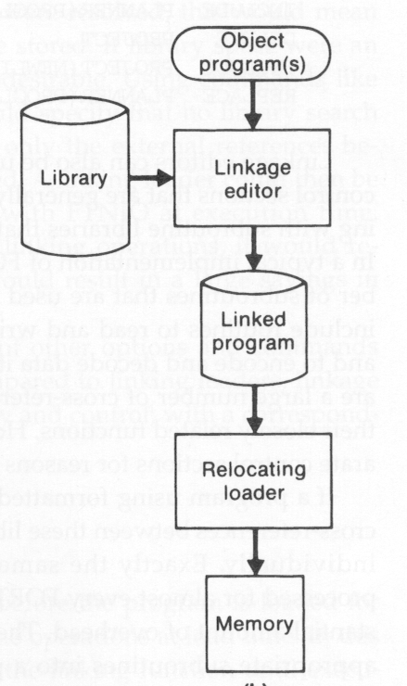
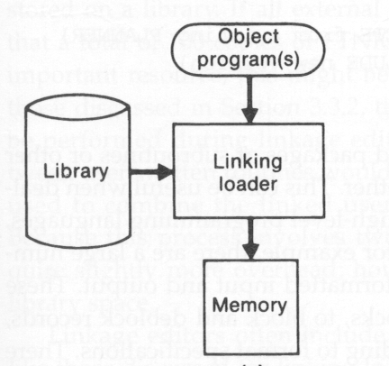
On PC Windows or UNIX operating
systems, normally you are using
a linkage editor to generate an
executable program.

Slide 24
Dynamic Linking
Linkage editors perform linking before the program is loaded for execution.
Linking loaders perform these same operations at load time.
Dynamic linking postpones the linking function until execution time.
  A subroutine is loaded and linked to the test of the program when it is first called.
Dynamic linking is often used to allow several executing programs to share one copy of a subroutine or library.
For example, a single copy of the standard C library can be loaded into memory.

Slide 25
Dynamic Linking Advantage
The subroutines that diagnose errors may never need to be called at all.
However, without using dynamic linking, these subroutines must be loaded and linked every time the program is run.
Using dynamic linking can save both space for storing the object program on disk and in memory, and time for loading the bigger object program.
MS-DOS Linker is example of Dynamic linker

Slide 26
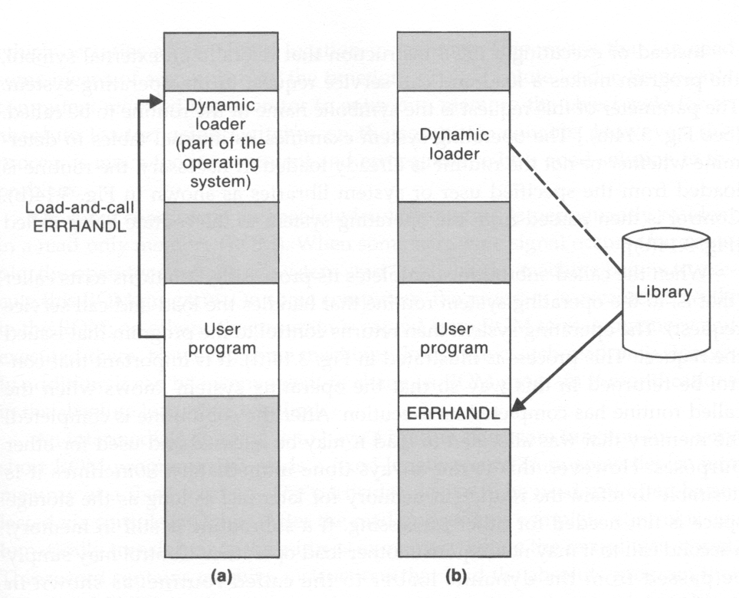
Implementation Example
Load the called
subroutine into
memory
Issue a load-and-call
service request

Slide 27
Thank you
Question?

